Slide 1
Debugging, Testing, and Backwards Compatibility
Android Developer Fundamentals
Lesson 3

Slide 2
3.1 Debugging Apps

Slide 3
Contents
All code has bugs
Android Studio logging
Android Studio debugger
Working with breakpoints
Changing variables
Stepping through code

Slide 4
All Code Has Bugs

Slide 5
Bugs
Incorrect or unexpected result, wrong values
Crashes, exceptions, freezes, memory leaks
Causes
Human Design or Implementation Error > Fix your code
Software fault, but in libraries > Work around limitation
Hardware fault or limitation -> Make it work with what's available
Origin of the term "bug" (it's not what you think)

Slide 6
Debugging
Find and fix errors
Correct unexpected and undesirable behavior
Unit tests help identify bugs and prevent regression
User testing helps identify interaction bugs

Slide 7
Android Studio debugging tools
Android Studio has tools that help you
identify problems
find where in the source code the problem is created
so that you can fix it
Notes:
.

Slide 8
Logging with Android Studio

Slide 9
Add log messages to your code
import android.util.Log;
// Use class variable with class name as tag
private static final String TAG = MainActivity.class.getSimpleName();
// Show message in Android Monitor, logcat pane
// Log.<log-level>(TAG, "Message");
Log.d(TAG, “Hello World”);

Slide 10
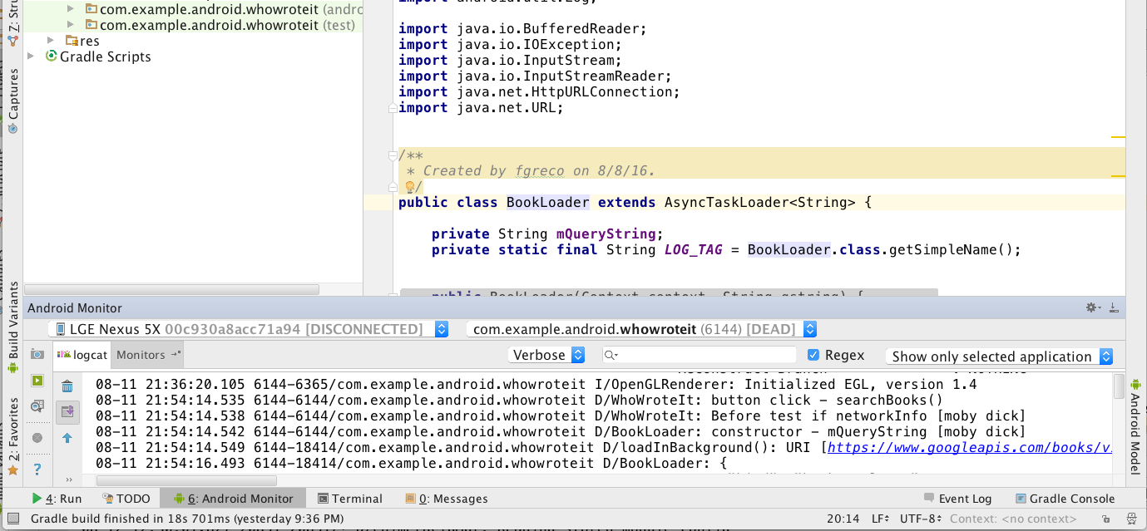
Open Android Monitor and logcat
logcat
pane
Android Monitor

Slide 11
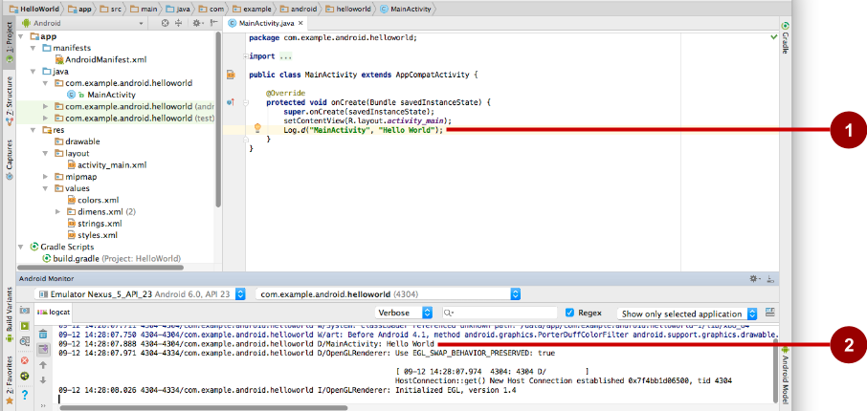
Inspect logging messages
Log.d("MainActivity", "Hello World");
09-12 14:28:07.971 4304 /com.example.android.helloworld D/MainActivity: Hello World

Slide 12
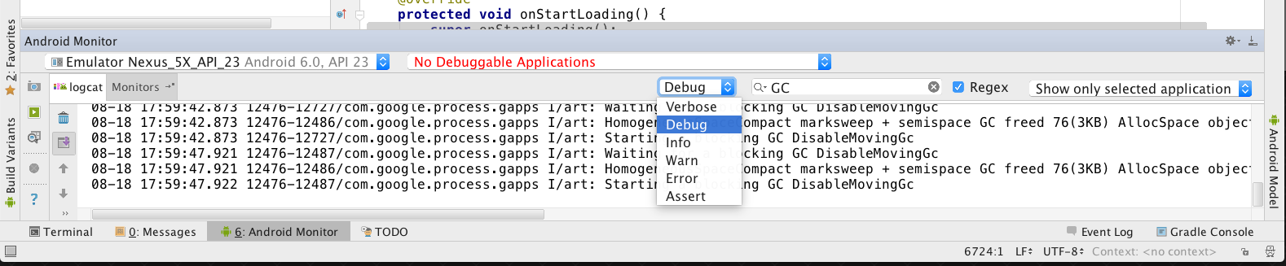
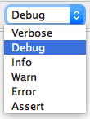
Choose visible logging level
Displays logs with levels at this level or higher

Slide 13
Log Levels
Verbose - All verbose log statements and comprehensive system
Debug - All debug logs, variable values, debugging notes
Info - Status info, such as database connection
Warning - Unexpected behavior, non-fatal issues
Error - Serious error conditions, exceptions, crashes only

Slide 14
Debugging with Android Studio

Slide 15
What you can do
Run in debug mode with attached debugger
Set and configure breakpoints
Halt execution at breakpoints
Inspect execution stack frames and variable values
Change variable values
Step through code line by line
Pause and resume a running program

Slide 16
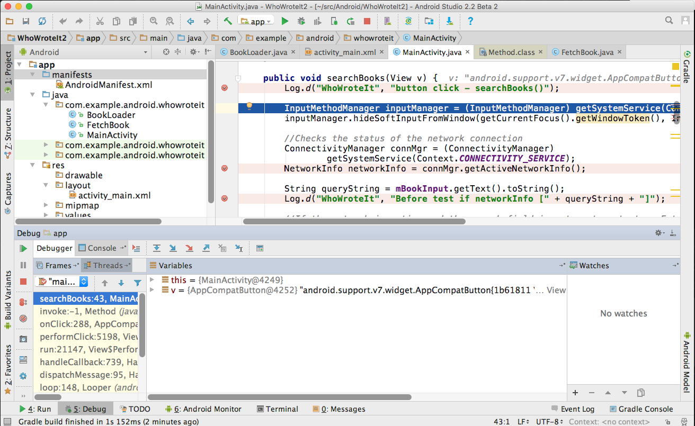
Run in debug mode
1
Debugger pane opens
Menu:
Run > Debug 'your app'
2

Slide 17
Set breakpoints
Click in the left margin next to executable line of code

Slide 18
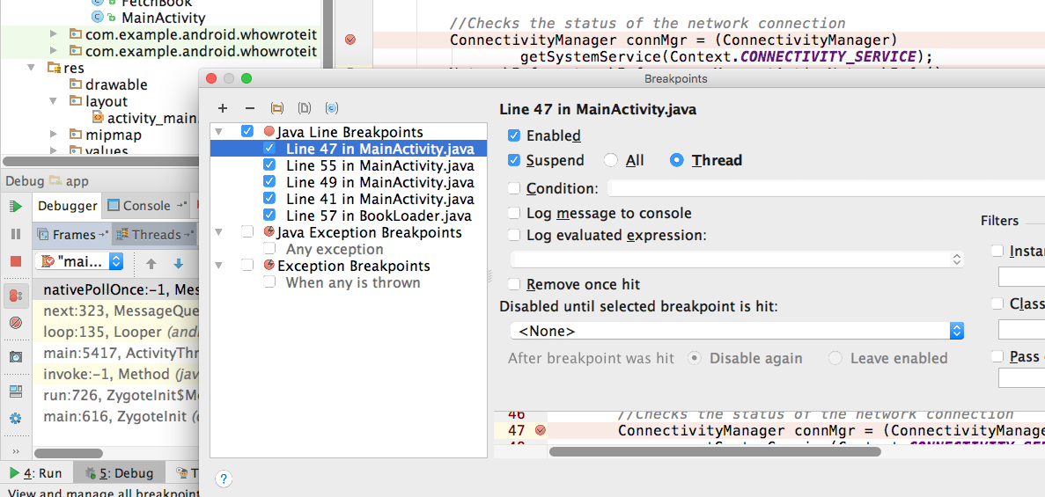
Edit breakpoint properties
2
1

Slide 19
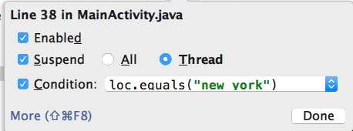
Make breakpoints conditional
In properties dialog or right -click existing breakpoint
Any Java expression that returns a boolean
Code completion helps you write conditions

Slide 20
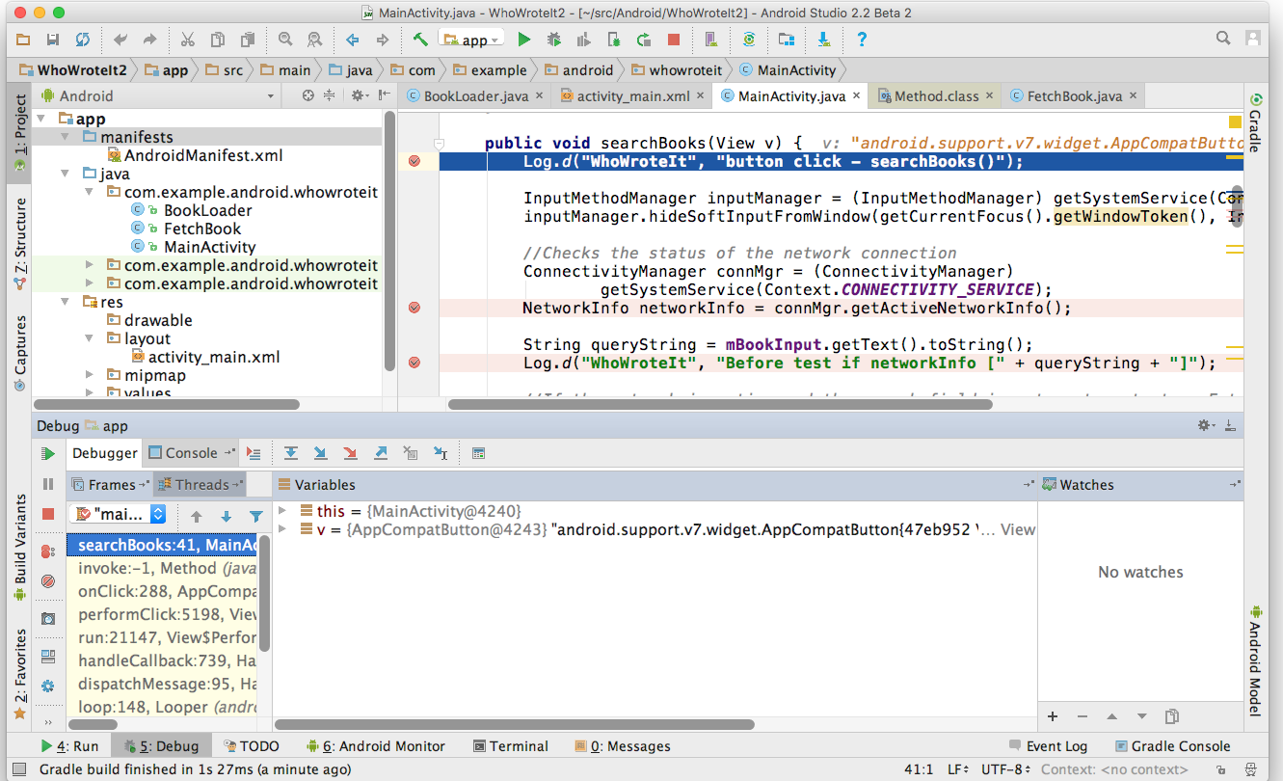
Run until app stops at breakpoint
First Breakpoint
Frames
Variables in scope
Watches (C/C++)

Slide 21
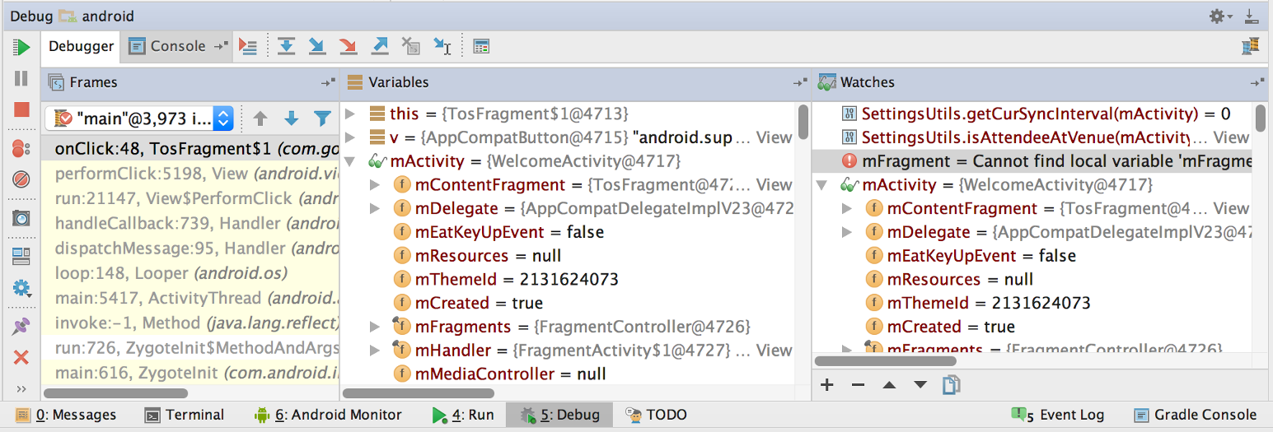
Inspect frames
Top frame is where execution is halted in your code

Slide 22
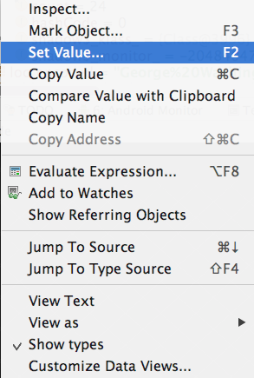
Inspect and edit variables
Right-click on variable for menu

Slide 23
Basic Stepping Commands
Step Over | F8 | Step to the next line in current file
Step Into | F7 | Step to the next executed line
Force Step Into | ⇧F7 | Step into a method in a class that you wouldn't normally step into, like a standard JDK class
Step Out | ⇧F8 | Step to first executed line after returning from current method
Run to Cursor | ⌥F9 | Run to the line where the cursor is in the file
Notes:
There are other stepping commands.

Slide 24
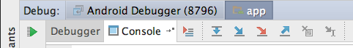
Stepping through code
Show execution point
Drop frame
Run to cursor
Step over
Step into
Step out
Force step into

Slide 25
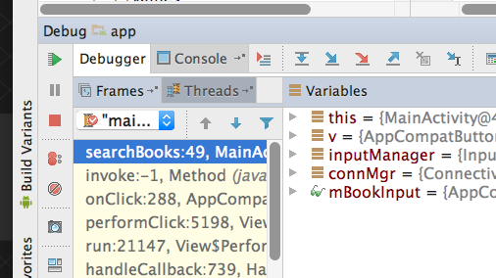
Resume and Pause
Resume
Pause
Mute all breakpoints
Menu:
Run->Pause Program…
Run->Resume Program...

Slide 26
Learn more
Debug Your App (Android Studio User Guide)
Debugging and Testing in Android Studio (video)

Slide 27
What's Next?
Concept Chapter: 3.1 C The Android Studio Debugger
Practical: 3.1 P Using the Debugger

Slide 28
END

